Slide 1
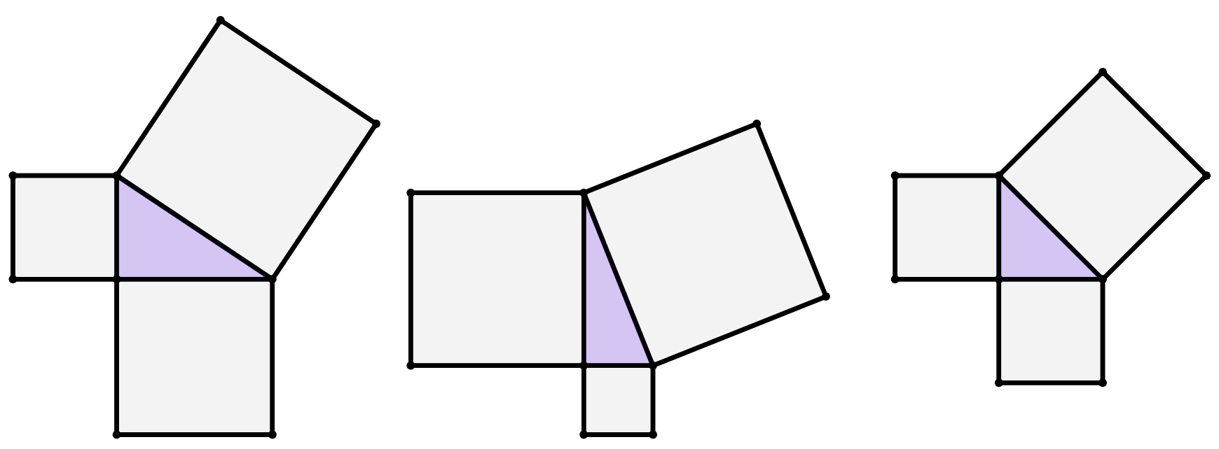
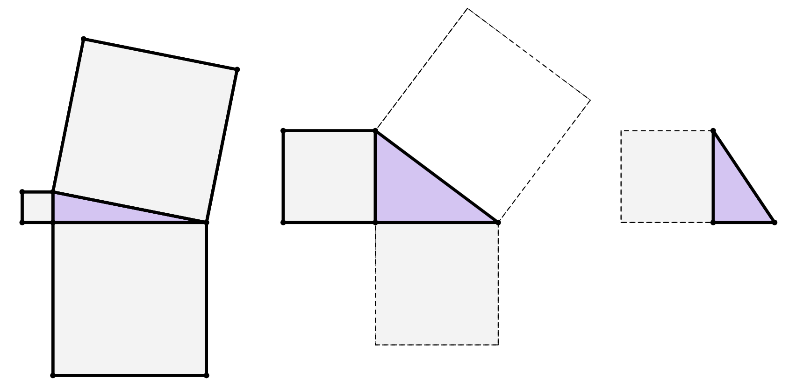
Length of a shorter side
Task A: Squares from the sides of a triangle
1) Find the area of each unlabelled square.
a)
b)
c)
area
570 cm²
114 cm²
29 cm
170 cm²
400
cm²
441
cm²
area
30 cm²
400 cm²
144 cm²
841 cm²
12 cm
20 cm
20 cm
2) By drawing on any missing squares first and calculating their areas, find the length of each side labelled with a letter.
625 cm²
625 cm²
area
29 cm²
225 cm²
25 cm
400 cm²
b cm
area
275 cm²
15 cm
25 cm
30 cm
c cm
a cm
15 cm
20 cm
14 cm
900 cm²
196 cm²
225 cm²
‹#›

Slide 2


Length of a shorter side
Task B: Using Pythagoras’ theorem to find a shorter side
1) Fill in all the blanks to complete the method to calculate the length of side e, rounded to 1 decimal place.
e
2
+
5
2
=
22
2
e²
+
25
=
484
e²
=
484 25
−
22 cm
e cm
e²
=
459
e
=
=
459 21.4 (1 d.p.)
5 cm
2) Which of these are correct representations of Pythagoras’ theorem to find the length of side c?
a
b
c² = 21² + 9²
c² = 21² − 9²
21 cm
c cm
c
d
21² = 9² + c²
21² = c² + 9²
e
f
9 cm
21² = 9² − c²
21² = c² − 9²
3) Using Pythagoras’ theorem, show fully that the value of w cm is 58.52 cm when rounded to 2 decimal places.
81 cm
56² + w² = 81²
w = 3425 = 58.5234996
56 cm
w cm
w² = 81² − 56²
w = 58.52, after rounding.
w² = 3425
4) Show that the perimeter of this triangle is 84 cm.
Let the missing length be called x.
Perimeter = 12 cm + 37 cm + 35 cm
37 cm
x² = 37² − 12² = 1225
Perimeter = 84 cm
x = 1225 = 35
12 cm
5) Match each triangle to a calculation and answer to find the length of its missing side.
a)
18 cm
b)
b cm
c)
g
31 cm
2 cm
12 cm
d
e
j
i
h
c cm
13 cm
a cm
34 cm
f
d
e
f
g
calculation
34² − 31²
169 − 2²
165
324 − 144
h
i
j
length of missing side
13.96 cm
13.42 cm
12.84 cm
Mathematics in Education and Industry.
‹#›

